Slide 1

Datatypes in Python

Slide 2
1. Numbers
The basic numerical types used in Python are:
• Integers.
• Floats (reals).
• Complex numbers.

Slide 3
Operations on Numbers
Python will automatically convert numbers from one type to another when appropriate.
The main arithmetic operations are +, -, *, /, and **. Operations are evaluated in standard order - Parentheses, Exponentiation, Multiplication, Division, Addition and Subtraction.

Slide 4
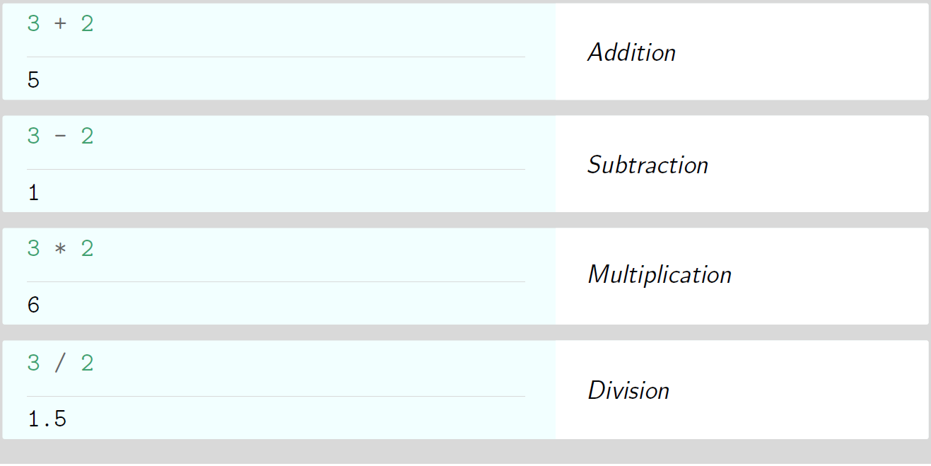
Operations on Numbers

Slide 5
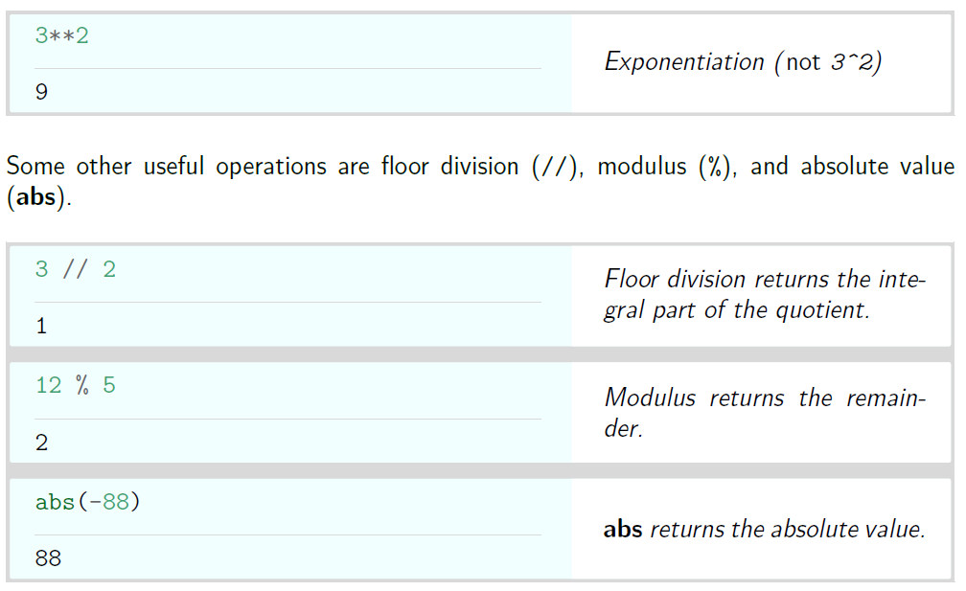
Operations on Numbers

Slide 6
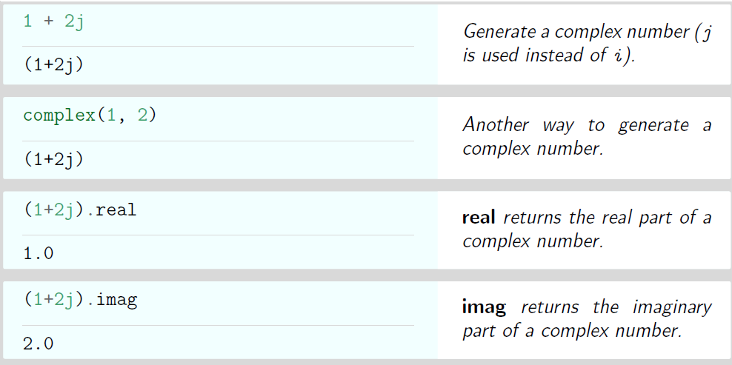
Complex arithmetic

Slide 7
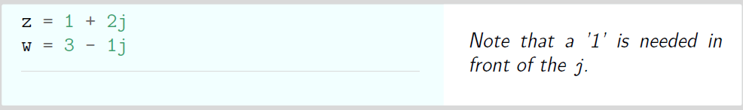
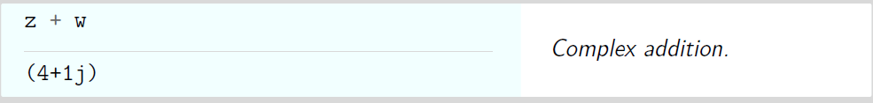
Complex Addition

Slide 8
2. Booleans

Slide 9
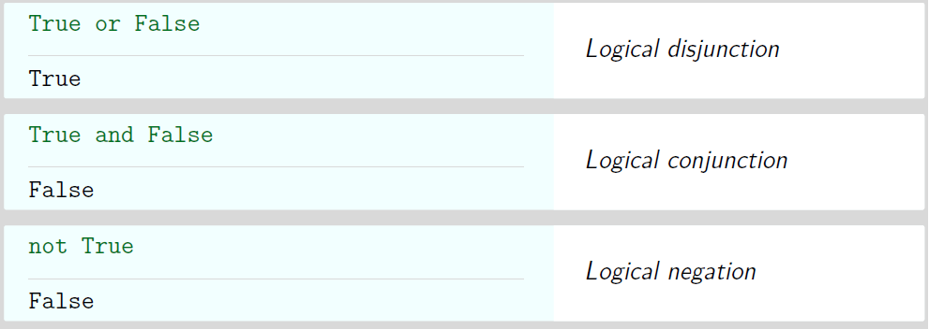
Booleans

Slide 10
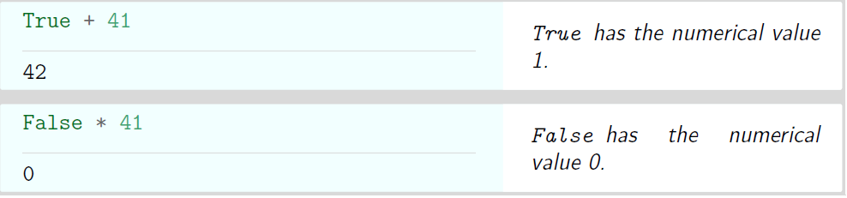
Booleans

Slide 11
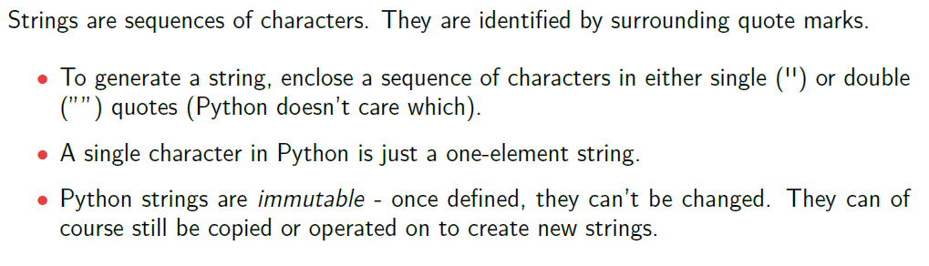
3. Strings

Slide 12
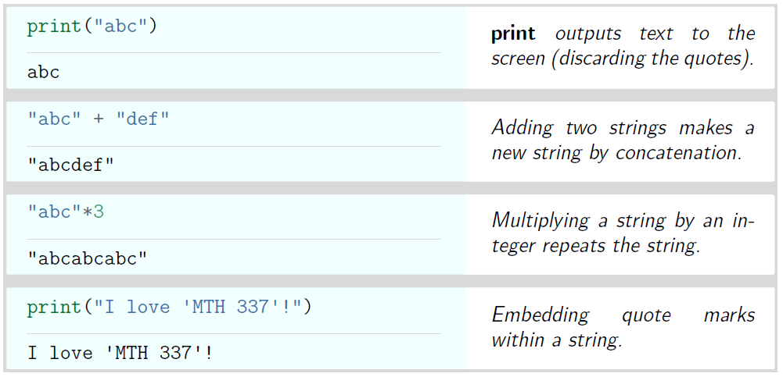
Strings

Slide 13
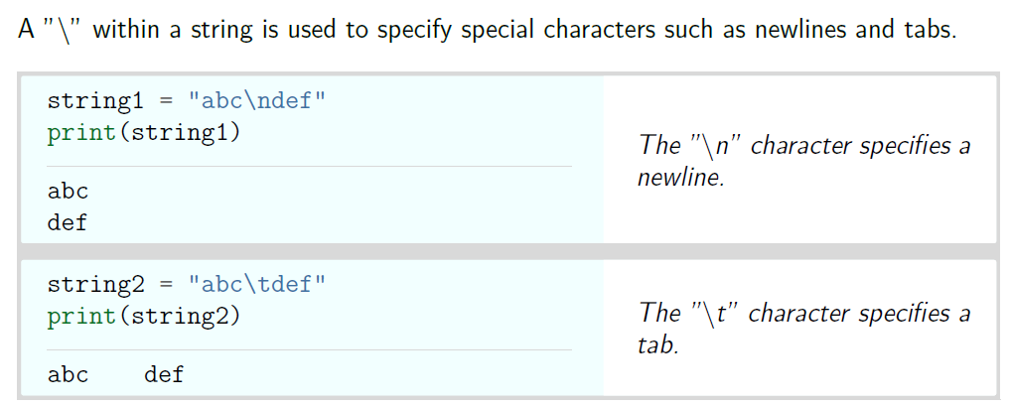
Strings

Slide 14
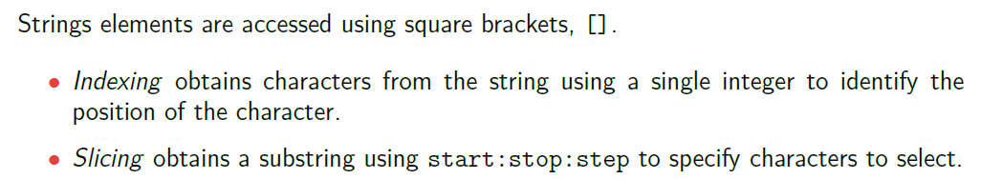
Strings

Slide 15
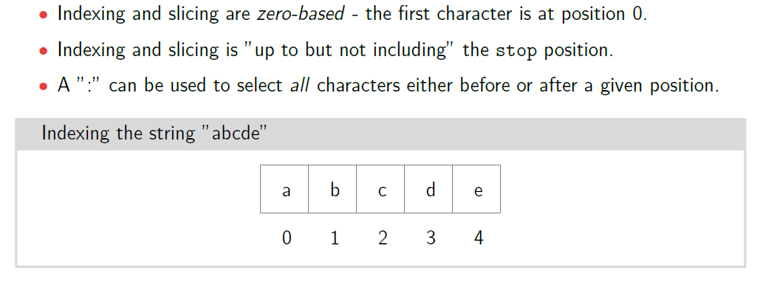
Strings

Slide 16
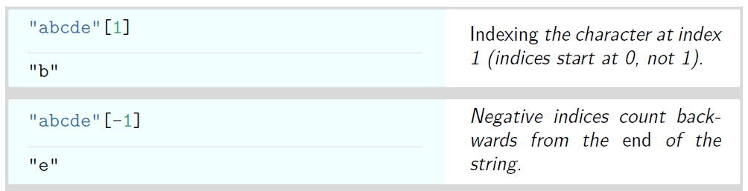
Strings

Slide 17
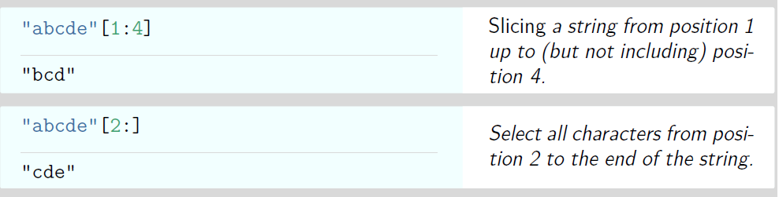
Strings

Slide 18
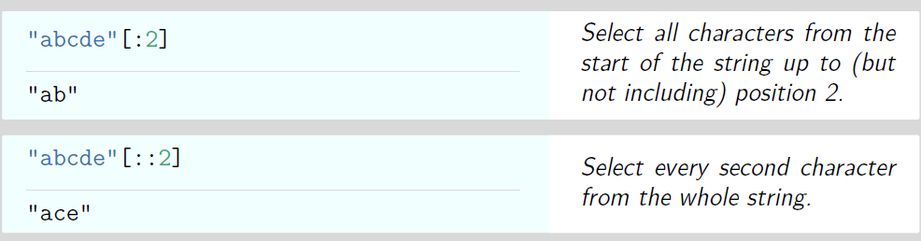
Strings

Slide 19
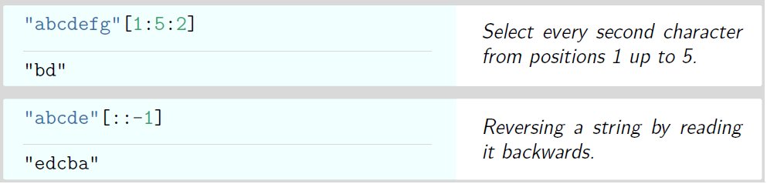
Strings

Slide 20
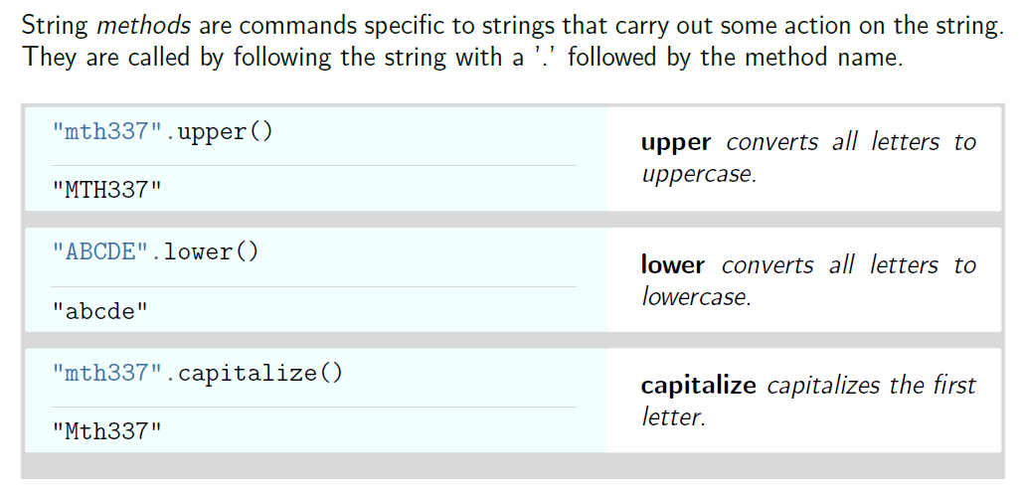
String Methods

Slide 21
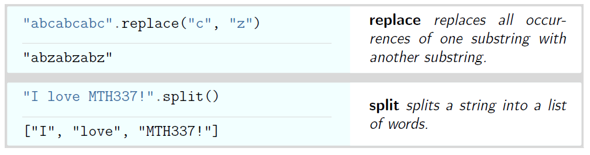
String Methods

Slide 22
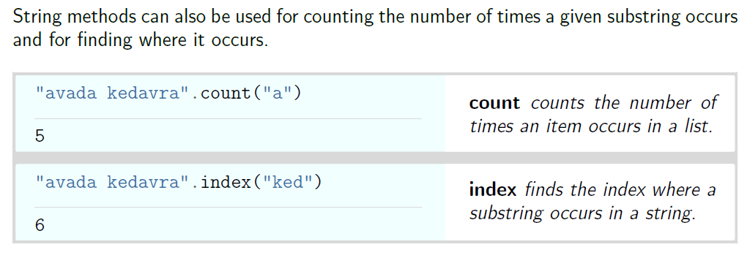
String Methods

Slide 23
Thank You

